Slide 1
Digital Design & Computer Arch. Lecture 2a: Course Goals & Logistics
Prof. Onur Mutlu
ETH Zürich
Spring 2020
21 February 2020

Slide 2
The Lecture Was Slightly Different When I Was at CMU

Slide 3
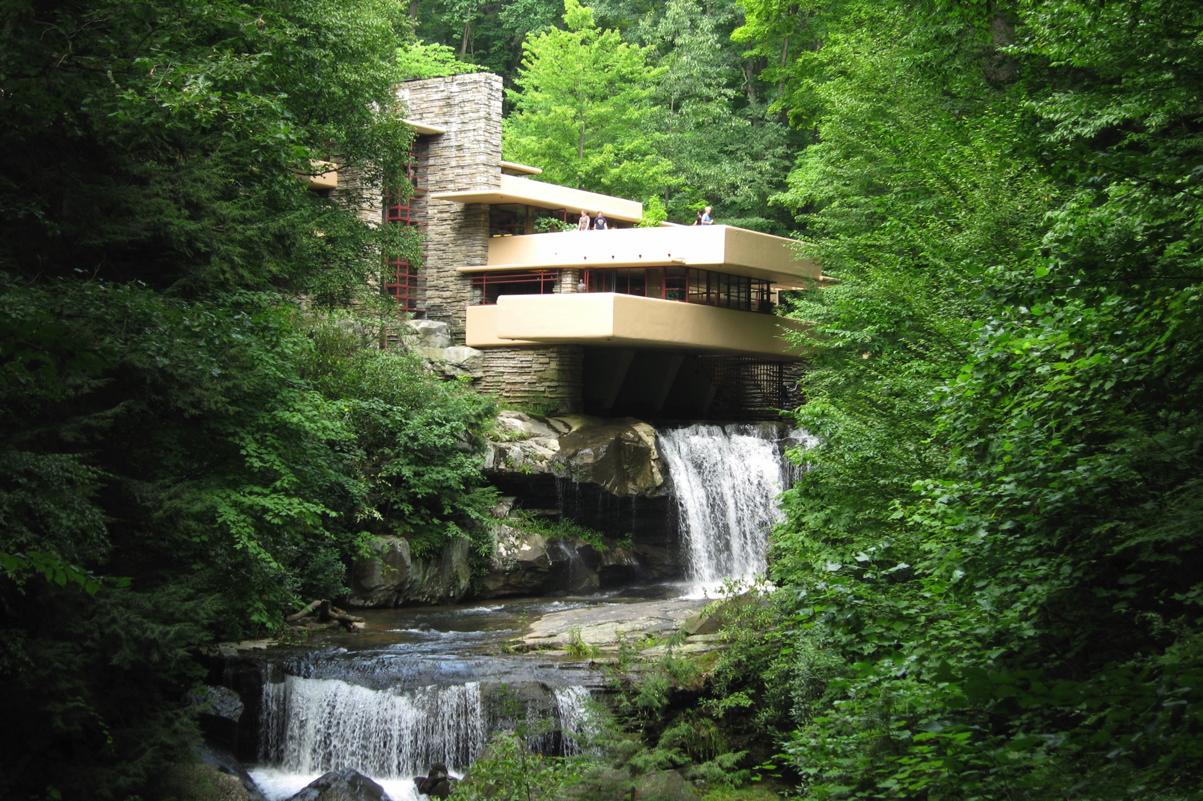
What Is This?
Source: https://roadtrippers.com/stories/falling-water

Slide 4
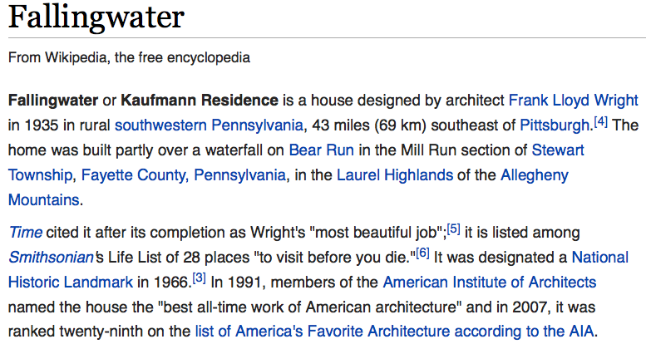
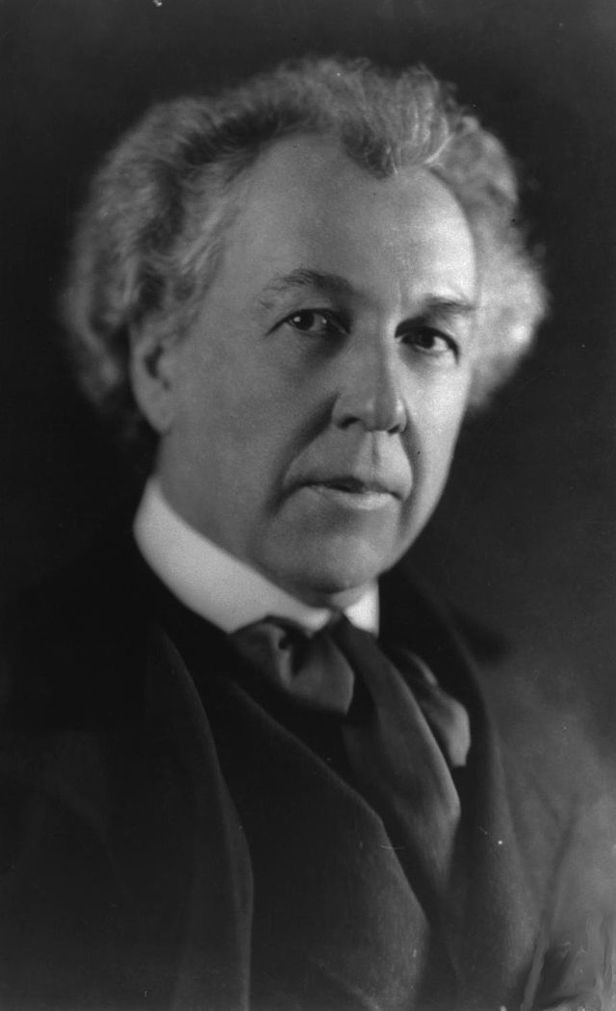
Answer: Masterpiece of A Famous Architect
Source: https://en.wikipedia.org/wiki/Fallingwater

Slide 5
Find The Differences of This and That

Slide 6
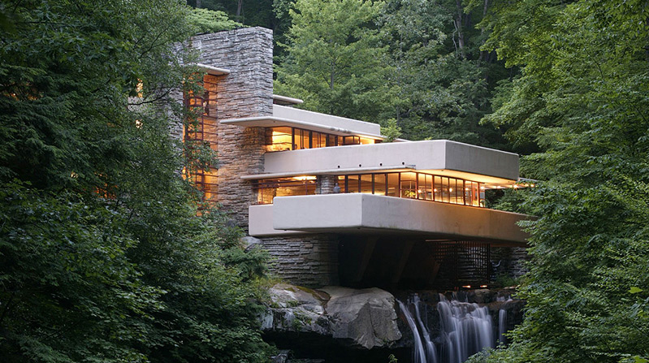
This
Source: http://www.fallingwater.org/

Slide 7
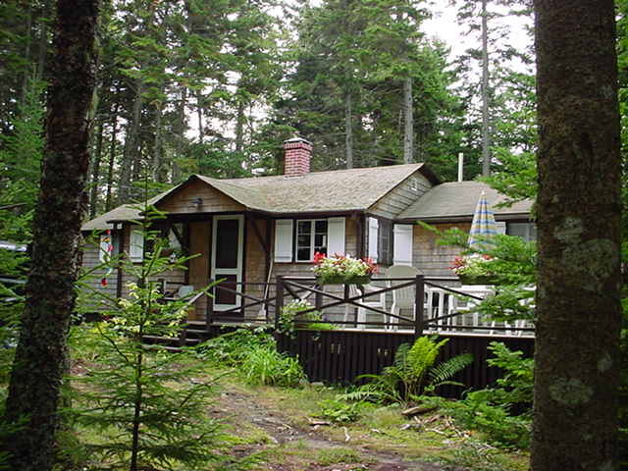
That

Slide 8
A Key Question
How was Wright able to design his masterpiece?
Can have many guesses
(Ultra) hard work, perseverance, dedication (over decades)
Experience
Creativity, Out-of-the-box thinking
A good understanding of past designs
Good judgment and intuition
Strong skill combination (math, architecture, art, engineering, …)
Funding ($$$$), luck, initiative, entrepreneurialism
Strong understanding of and commitment to fundamentals
Principled design
…
(You will be exposed to and hopefully develop/enhance many of these skills in this course)

Slide 9
A Quote from The Architect Himself
“architecture […] based upon principle, and not upon precedent”
Source: http://www.fallingwater.org/

Slide 10
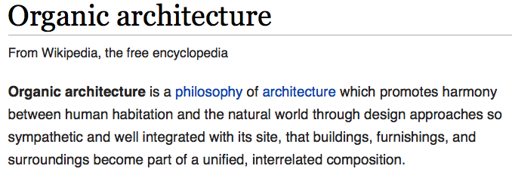
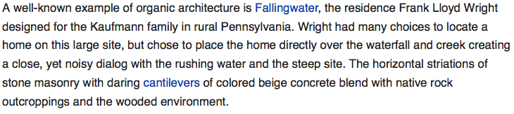
A Principled Design

Slide 11
A Key Question
How was Wright able to design his masterpiece?
Can have many guesses
(Ultra) hard work, perseverance, dedication (over decades)
Experience
Creativity, Out-of-the-box thinking
A good understanding of past designs
Good judgment and intuition
Strong skill combination (math, architecture, art, engineering, …)
Funding ($$$$), luck, initiative, entrepreneurialism
Strong understanding of and commitment to fundamentals
Principled design
…
(You will be exposed to and hopefully develop/enhance many of these skills in this course)

Slide 12
Takeaways
It all starts from the basic building blocks and design principles
And, knowledge of how to use & apply them
Underlying technology might change (e.g., steel vs. wood)
but methods of taking advantage of technology bear resemblance
methods used for design depend on the principles employed

Slide 13
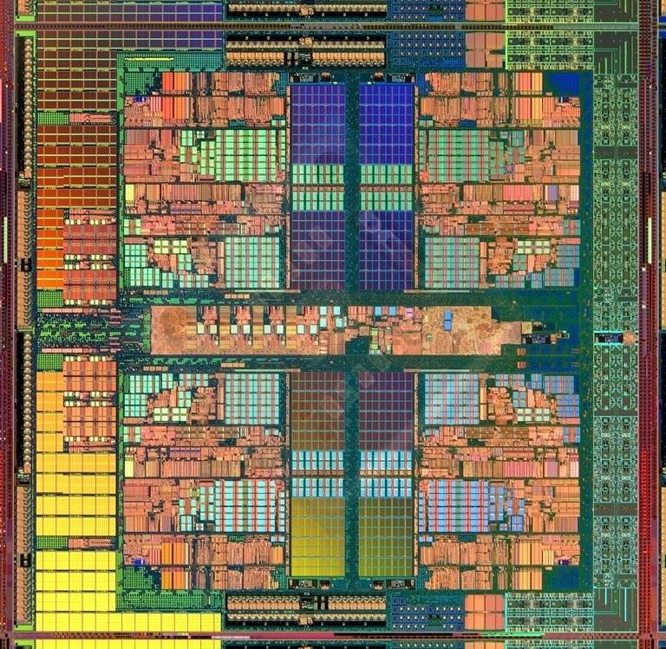
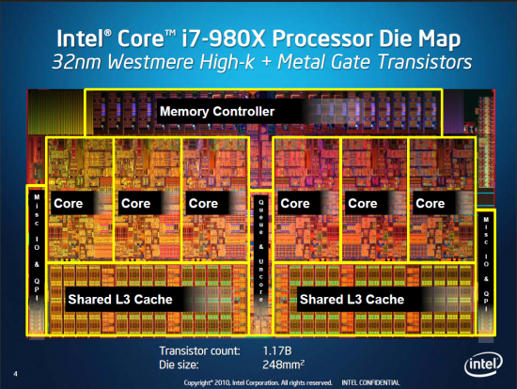
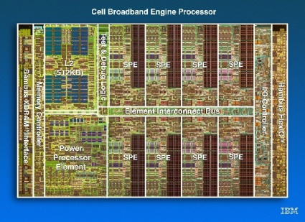
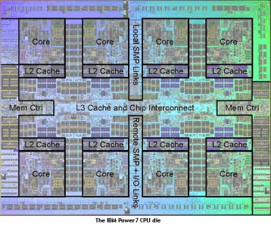
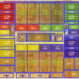
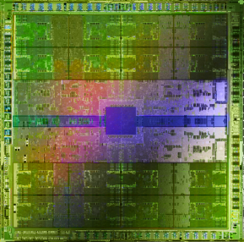
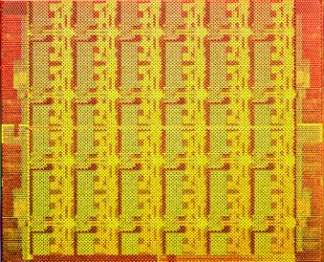
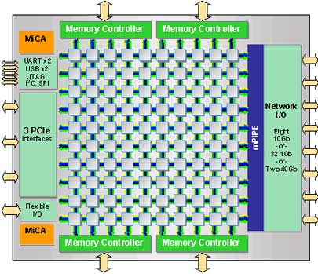
The Same Applies to Processor Chips
There are basic building blocks and and design principles
Intel Core i7 8 cores
IBM Cell BE 8+1 cores
IBM POWER7
8 cores
AMD Barcelona
4 cores
Nvidia Fermi
448 “cores”
Intel SCC
48 cores, networked
Tilera TILE Gx
100 cores, networked
Sun Niagara II
8 cores

Slide 14
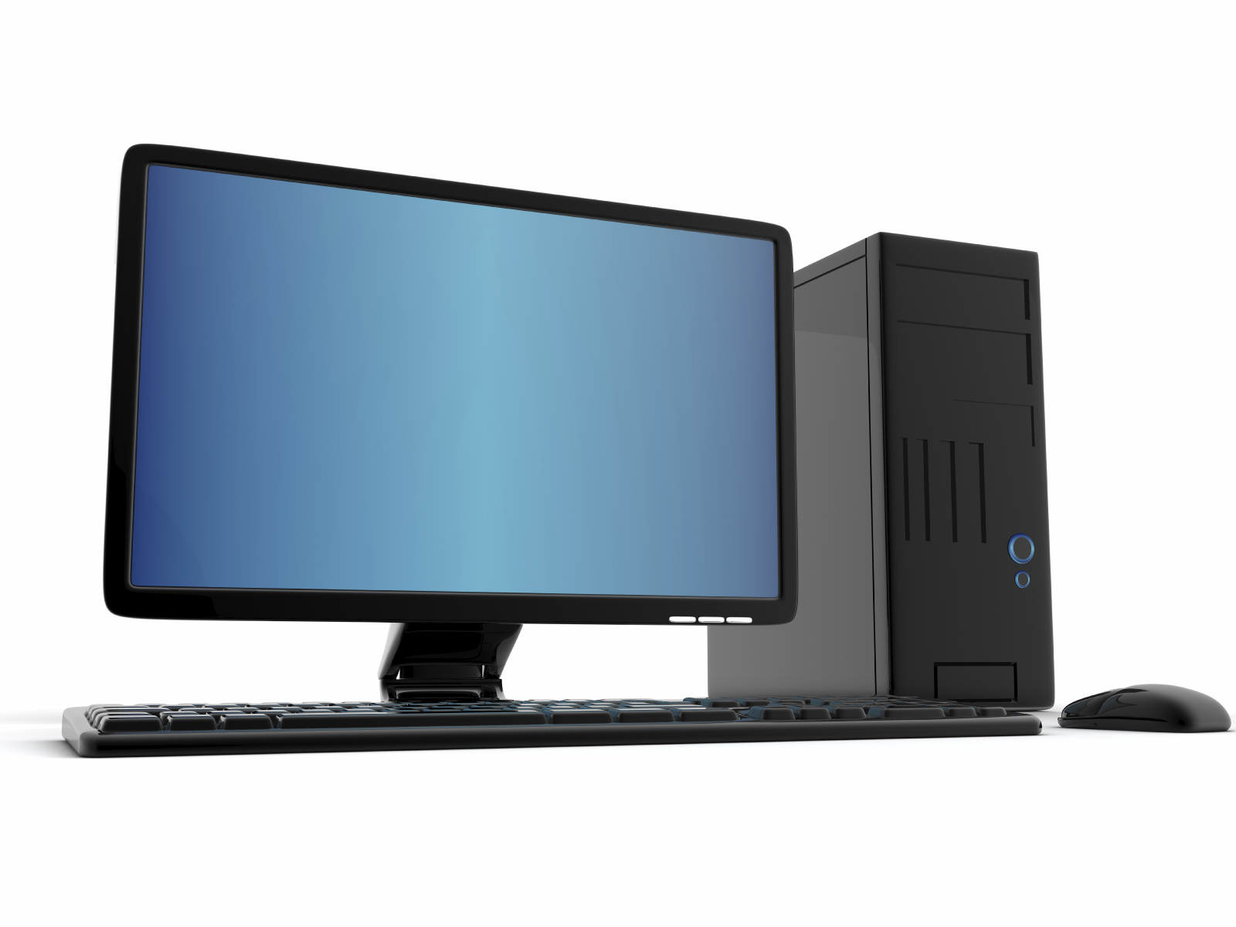
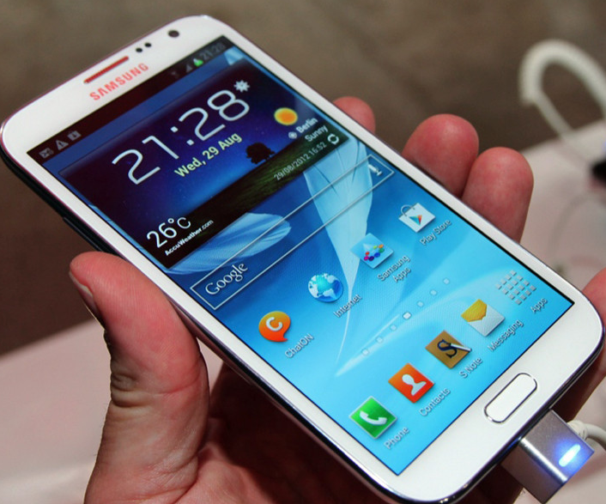
The Same Applies to Computing Systems
There are basic building blocks and and design principles
source: http://www.sia-online.org (semiconductor industry association)

Slide 15
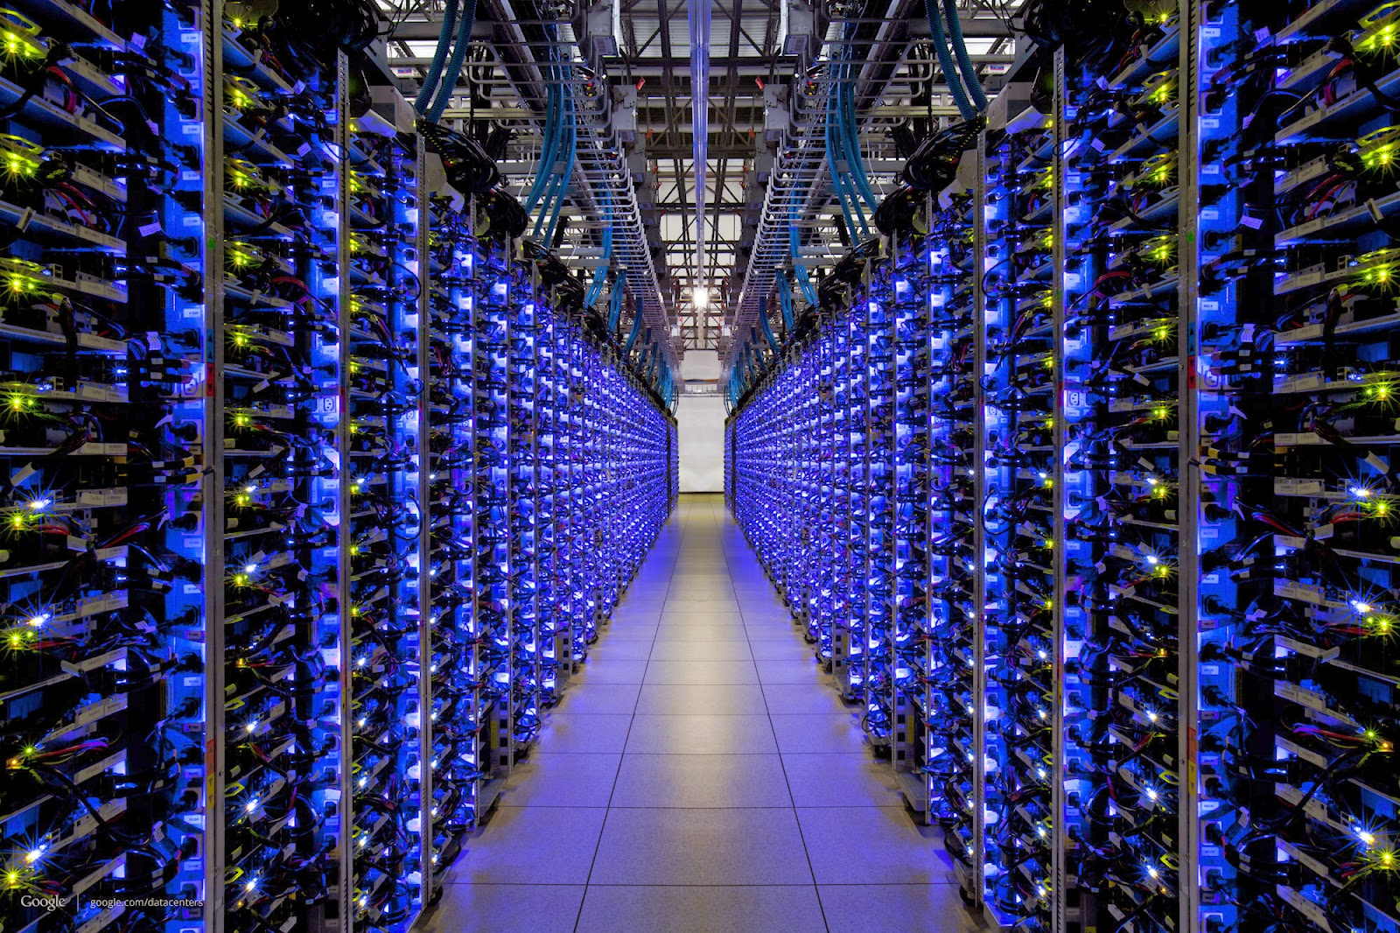
The Same Applies to Computing Systems
There are basic building blocks and and design principles
Source: http://datacentervoice.com/wp-content/uploads/2015/10/data-center.jpg

Slide 16
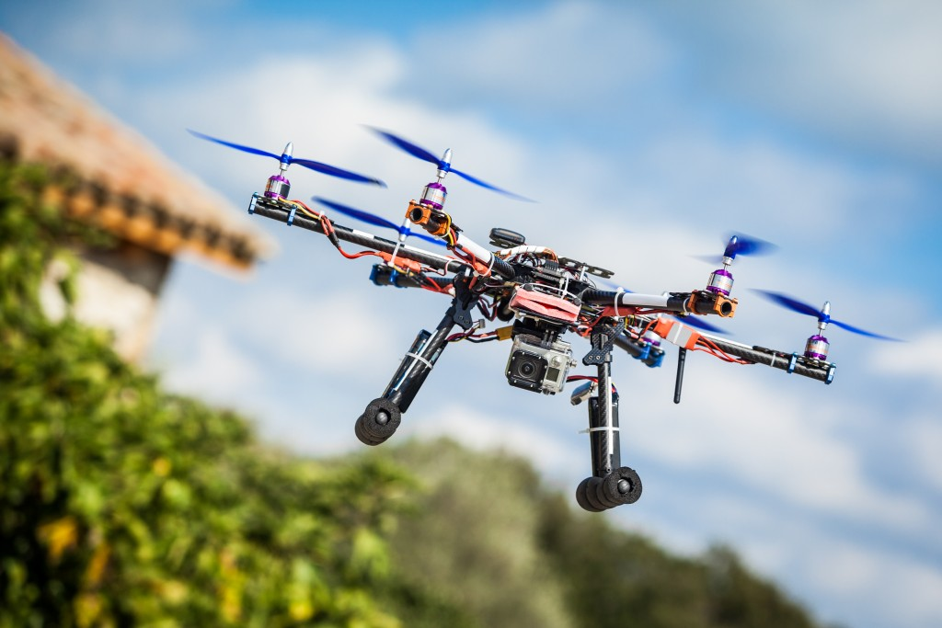
Different Platforms, Different Goals
Source: https://iq.intel.com/5-awesome-uses-for-drone-technology/

Slide 17
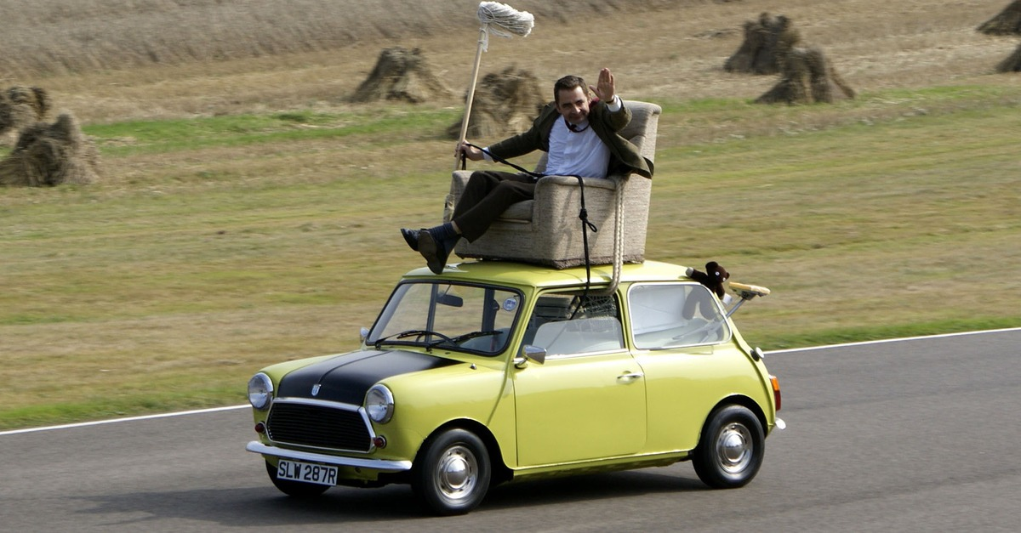
Different Platforms, Different Goals
Source: https://taxistartup.com/wp-content/uploads/2015/03/UK-Self-Driving-Cars.jpg

Slide 18
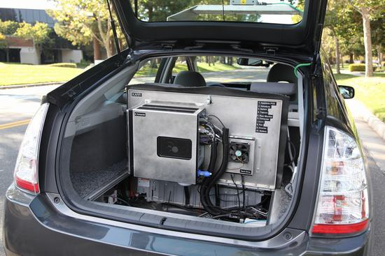
Different Platforms, Different Goals
Source: http://sm.pcmag.com/pcmag_uk/photo/g/google-self-driving-car-the-guts/google-self-driving-car-the-guts_dwx8.jpg

Slide 19
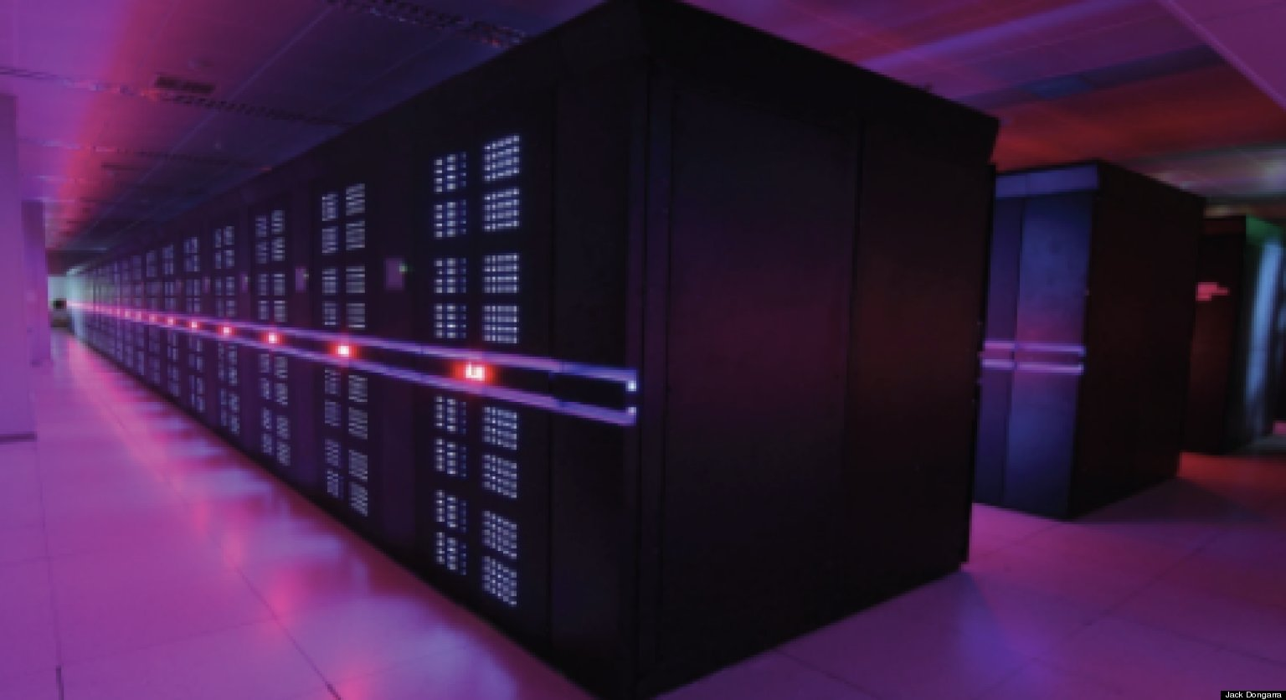
Different Platforms, Different Goals
Source: https://fossbytes.com/wp-content/uploads/2015/06/Supercomputer-TIANHE2-china.jpg

Slide 20
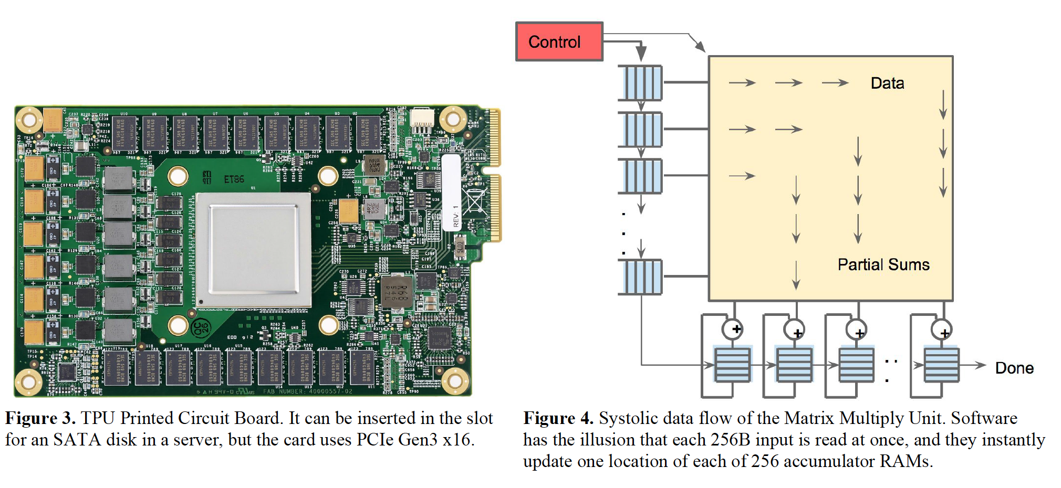
Different Platforms, Different Goals
Jouppi et al., “In-Datacenter Performance Analysis of a Tensor Processing Unit”, ISCA 2017.

Slide 21
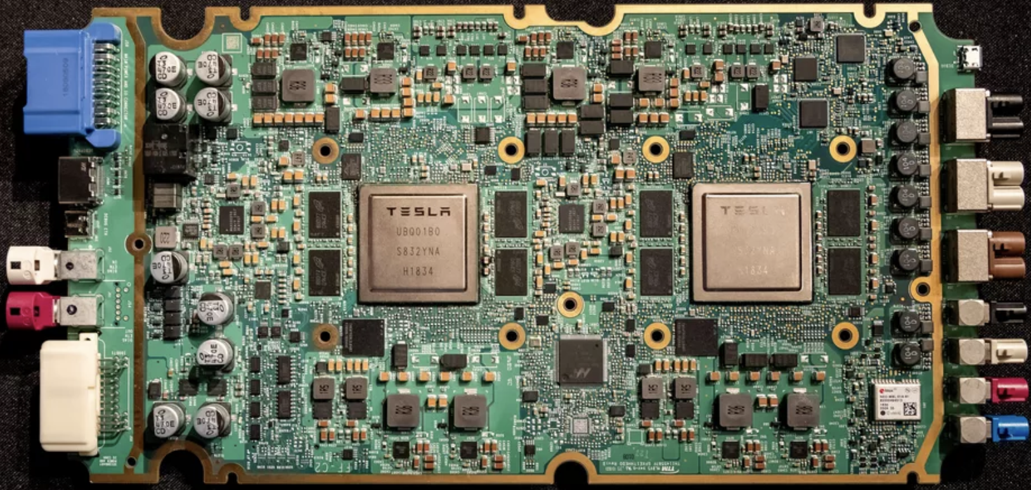
Different Platforms, Different Goals
ML accelerator: 260 mm², 6 billion transistors, 600 GFLOPS GPU, 12 ARM 2.2 GHz CPUs.
Two redundant chips for better safety.
https://youtu.be/Ucp0TTmvqOE?t=4236

Slide 22
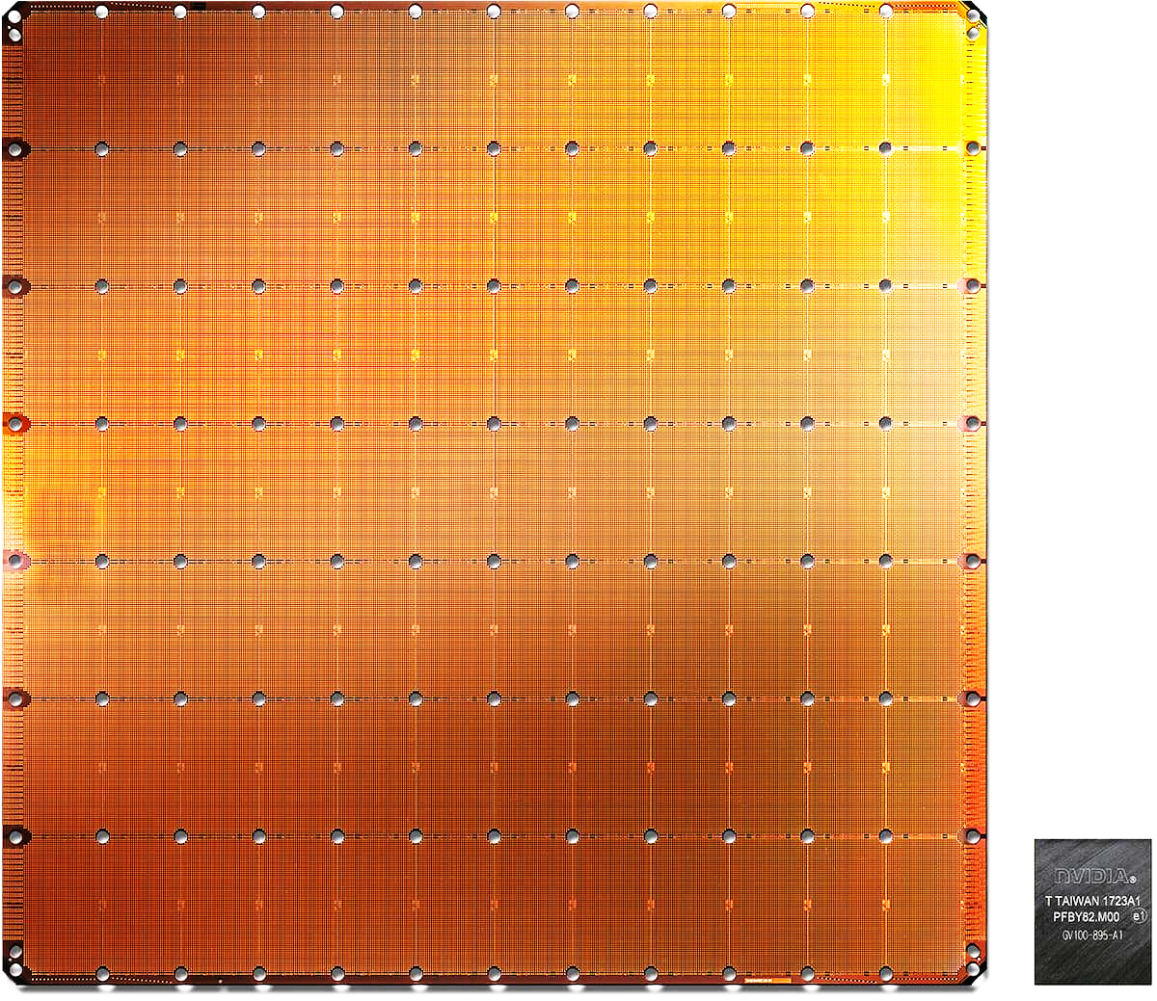
Different Platforms, Different Goals
The largest ML
accelerator chip
400,000 cores
Cerebras WSE
1.2 Trillion transistors
46,225 mm²
Largest GPU
21.1 Billion transistors
815 mm²
NVIDIA TITAN V
https://www.anandtech.com/show/14758/hot-chips-31-live-blogs-cerebras-wafer-scale-deep-learning
https://www.cerebras.net/cerebras-wafer-scale-engine-why-we-need-big-chips-for-deep-learning/
Notes:
The Wafer-Scale Engine is the most massive AI chip ever produced and packs a whopping 400,000 cores in a 46,225mm2 footprint.

Slide 23
Basic Building Blocks
Electrons
Transistors
Logic Gates
Combinational Logic Circuits
Sequential Logic Circuits
Storage Elements and Memory
…
Cores
Caches
Interconnect
Memories
...

Slide 24
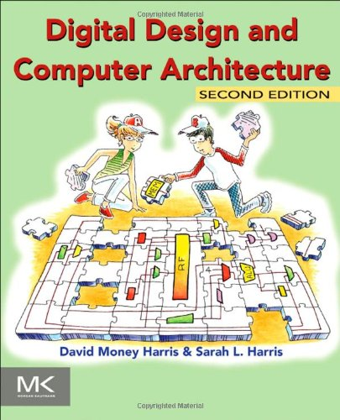
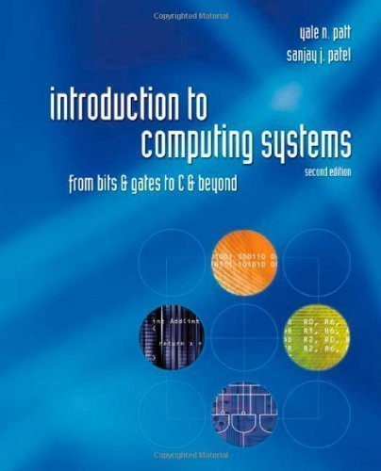
Reading Assignments for This Week
Chapter 1 in Harris & Harris
Chapters 1-2 in Patt and Patel
Supplementary Lecture Slides on Binary Numbers

Slide 25
Major High-Level Goals of This Course
In Digital Circuits & Computer Architecture
Understand the basics
Understand the principles (of design)
Understand the precedents
Based on such understanding:
learn how a modern computer works underneath
evaluate tradeoffs of different designs and ideas
implement a principled design (a simple microprocessor)
learn to systematically debug increasingly complex systems
Hopefully enable you to develop novel, out-of-the-box designs
The focus is on basics, principles, precedents, and how to use them to create/implement good designs

Slide 26
Why These Goals?
Because you are here for a Computer Science degree
Regardless of your future direction, learning the principles of digital design & computer architecture will be useful to
design better hardware
design better software
design better systems
make better tradeoffs in design
understand why computers behave the way they do
solve problems better
think “in parallel”
think critically
…

Slide 27
Course Info and Logistics

Slide 28
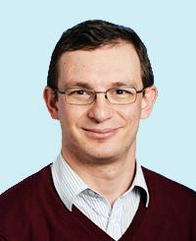
Course Info: Instructor
Onur Mutlu
Professor @ ETH Zurich CS, since September 2015 (started May 2016)
Strecker Professor @ Carnegie Mellon University ECE/CS, 2009-2016, 2016-…
PhD from UT-Austin, worked at Google, VMware, Microsoft Research, Intel, AMD
https://people.inf.ethz.ch/omutlu/
omutlu@gmail.com (Best way to reach me)
Office hours: By appointment (email me)
Research and Teaching in:
Computer architecture, computer systems, bioinformatics, hardware security
Memory and storage systems
Hardware security
Fault tolerance
Hardware/software cooperation
Genome analysis and application-algorithm-hardware co-design
…

Slide 29
Course Info: Lecturer & PhD Assistants
Head Assistant
Dr. Juan Gómez Luna
Vice-Head Assistant
Hasan Hassan
Lecturer
Dr. Frank Gurkaynak
(Other) Key Assistants and Guest Lecturers
Dr. Mohammed Alser
Dr. Lois Orosa
Dr. Jawad Haj-Yahya
Dr. Jisung Park

Slide 30
Course Info: PhD Assistants
(Other) Key Assistants and Guest Lecturers (cont.)
Minesh Patel
Giray Yaglikci
Can Firtina
Geraldo De Oliveira Junior
Rahul Bera
Konstantinos Kanellopoulos

Slide 31
Course Info: Student Assistants
Roknoddin Azizibarzoki
Tim Fischer
Lukas Gygi
Leo Horné
Lara Lazier
Artur Melo
Chris Mnuk
Nathan Neike
Arpan Prasad
Nina Richter
João Dinis Sanches Ferreira
Taha Shahroodi
Roberto Starc

Slide 32
Course Info: Lab Assistants (I)
Tuesday 15-17
TBD
Wednesday 15-17
TBD

Slide 33
Course Info: Lab Assistants (II)
Friday 8-10
TBD
Friday 10-12
TBD

Slide 34
If You Need Help
Post your question on Q&A Forum (soon announced)
Preferred for technical questions
Write an e-mail to:
digitaltechnik@lists.inf.ethz.ch
The instructor and all assistants will receive this e-mail
Come to office hours (CAB H 31.2)
Monday 1:30pm-2:30pm
Tuesday: 5pm-6pm
Wednesday: 10am-11am
We might need to change the room due to space limitations. In that case, we will announce it in advance

Slide 35
Where to Get Up-to-date Course Info?
Website:
https://safari.ethz.ch/digitaltechnik/
Lecture slides and videos
Readings
Lab information
Course schedule, handouts, FAQs
Software
Plus other useful information for the course
Check frequently for announcements and due dates
This is your single point of access to all resources
Your ETH Email
Lecturers and Teaching Assistants

Slide 36
Lecture and Lab Times and Policies
Lectures:
Thursday and Fridays, 13:15-15:00
HG F7 (F5 overflow)
Attendance is for your benefit and is therefore important
Some days, we will have guest lectures and exercise sessions
Lab sessions:
See online
You should definitely attend the lab sessions
In-class evaluation (70%) and mandatory lab reports (30%)
Labs will start on February 28th
Lab information and handouts are here:
https://safari.ethz.ch/digitaltechnik/spring2020/doku.php?id=labs

Slide 37
Lab Organization
Groups
Choose your preferred group in Moodle
https://moodle-app2.let.ethz.ch/mod/choicegroup/view.php?id=412173
Due 24.02.2020 at 11:59pm
Choose your partner
https://moodle-app2.let.ethz.ch/mod/feedback/view.php?id=418396
Due 24.02.2020 at 11:59pm
Lab grades from previous years
https://moodle-app2.let.ethz.ch/mod/choice/view.php?id=412175
Choose among (due 26.02.2020 at 11:59pm):
1) I will use my lab grades from previous years, and I won't do the labs this year
2) I will use my lab grades from previous years, but I will do the labs this year
3) I won't use my lab grades from previous years. I will do the labs this year

Slide 38
Final Exam
180-minute written exam
Find examination rules in Course Catalogue
Also in the first page of previous exams
https://safari.ethz.ch/digitaltechnik/spring2020/doku.php?id=exams
Some exam questions are similar to questions in Optional HWs
Optional HWs are optional, but highly recommended

Slide 39
Reading Assignments for This Week
Chapter 1 in Harris & Harris
Chapters 1-2 in Patt and Patel
Supplementary Lecture Slides on Binary Numbers

Slide 40
Reading Assignments for Next Week
Combinational Logic chapters from both books
Patt and Patel, Chapter 3
Harris and Harris, Chapter 2
Check course website for all future readings
Required
Recommended
Mentioned

Slide 41
Digital Design & Computer Arch. Lecture 2a: Course Goals & Logistics
Prof. Onur Mutlu
ETH Zürich
Spring 2020
21 February 2020

